Slide 1
Special Projects/Grant Updates for Charter Schools
September 12, 2024
Special Projects Department
Pinellas County Schools

Slide 2
Part 1:
SmartSheet Overview

Slide 3
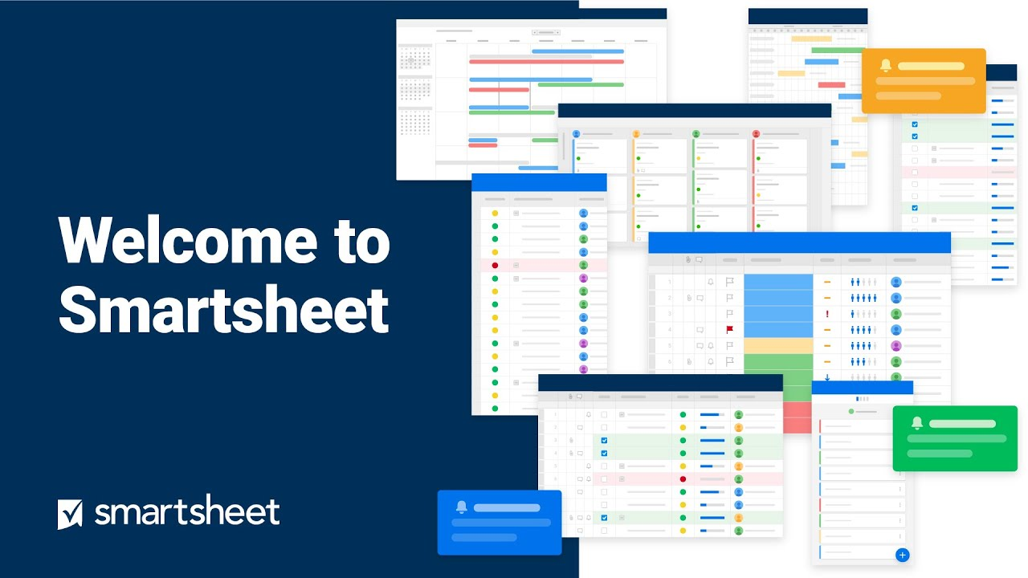
Smartsheet Overview

Slide 4



Smartsheet Overview
SPECIAL PROJECTS

Slide 5
Part 2:
Reimbursement Process as of July 2024

Slide 6
Charter Reimbursement Process
Cover Letter
Invoice
Proof of Payment
1
2
3

Slide 7
Charter Reimbursement Process
Cover Letter
Invoice
Proof of Payment
1
2
3
All cover letters must include the following attestation statement (statement updated 9/2024). See cover letter example.
I, _________________________(principal/administrator), certify to the best of my knowledge and belief that the information provided herein is true, complete, and accurate. I am aware that the provision of false, fictitious, or fraudulent information, or the omission of any material fact, may subject me to criminal, civil, or administrative consequences including, but not limited to violations of U.S. Code Title 18, Section 2. 1001, 1343 and Title 31,Sections 3729-3730 and 3801-3812.
[name of school] further attests that this request for reimbursement is for valid expenditures and complies with all applicable state rules and federal regulations, including, but not limited to, the applicable federal Office of Management and Budget Circulars; the federal Education Department General Administrative Regulations; and program-specific statutes, rules, and regulations. The school further states that these expenditures are necessary, reasonable, and allocable to achieving the grant objectives.

Slide 8
Charter Reimbursement Process
Cover Letter
Invoice
Proof of Payment
1
2
3
The school will continue providing an invoice for the total amount to be reimbursed. We have revised the Excel template for itemizing each expense. Each individual expense should be listed on a separate line. The total of all lines should equal the invoice total. Every invoice must have an Excel support document. This process is similar but the template was revised to eliminate unneeded information. See Excel Invoice Template.

Slide 9
Charter Reimbursement Process
Cover Letter
Invoice
Proof of Payment
1
2
3
Proof of payment support documentation options are listed for three types of expenditures:
- Payroll expenditures for internal staff
- Vendor payments for invoiced products and services
- Merchant receipts for P-Card or vendor check purchases

Slide 10
Charter Reimbursement Process
Cover Letter
Invoice
Proof of Payment
1
2
3
A Note About Personal Identifying Information

Slide 11
Charter Reimbursement Process
4
Submitting Reimbursement Requests
PCS will now be using the Smartsheet platform to automate the reimbursement process. This will ensure better transparency and feedback. Instead of emailing reimbursement documentation to different people, charter schools will use this link to submit the documentation directly for any grant. This link will be used for all grants charters are seeking reimbursement for. Smartsheet will funnel the request to the correct team in Special Projects and you will receive notification of approval, completion and any questions all through the smartsheet system. Submit Reimbursement Requests Here

Slide 12
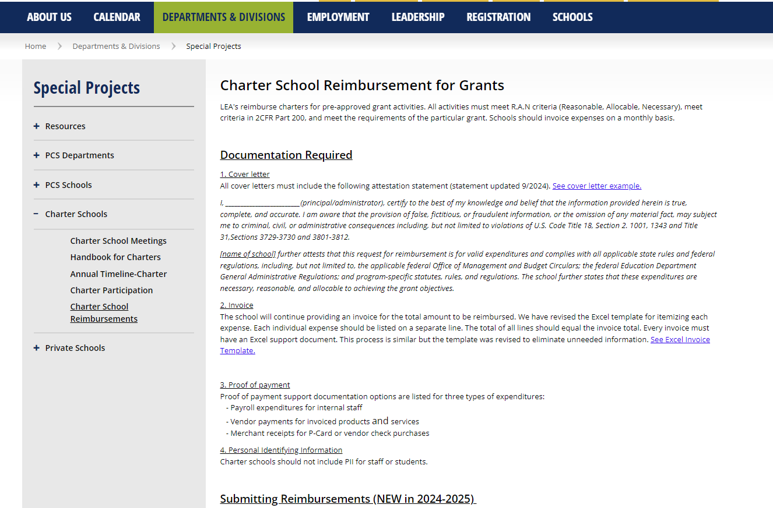
Charter Reimbursement Process

Slide 13
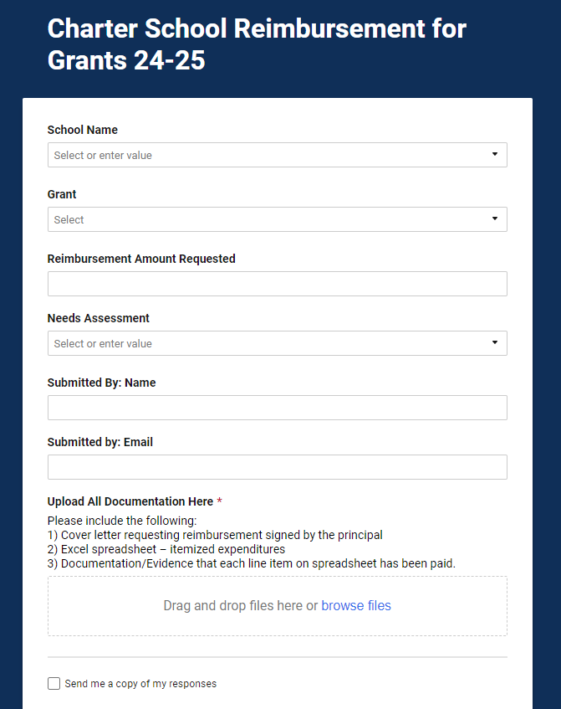
Charter Reimbursement Process

Slide 14
Reimbursement Hangups
Bank Back Up – partial months
Addition - Total amount on itemized spreadsheet
Tax - not removed on purchases, receipts, etc.
Frequency – combining many months
Overabundance of unnecessary back up

Slide 15
Part 3:
R.A.N

Slide 16
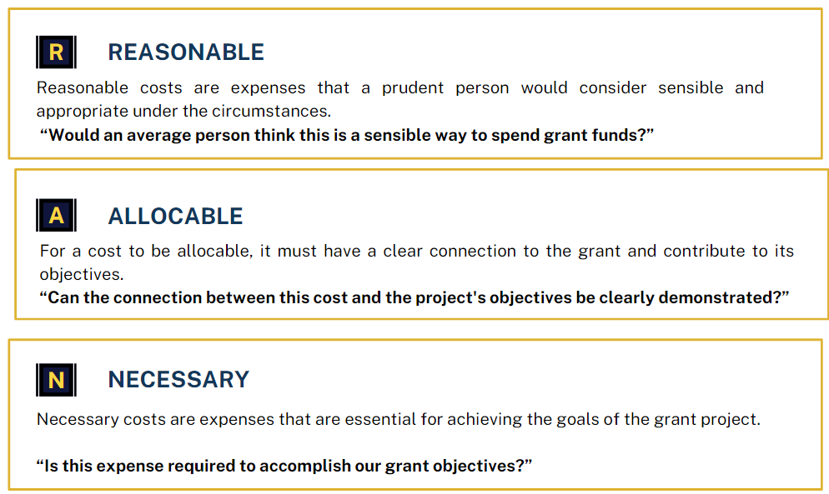

Slide 17
Part 4:
Taggable Items

Slide 18
Taggable Items – Quick Note
Please make sure that when you receive tags for taggable items that you complete the form that comes with them which provides us with the serial number. When this is returned to purchasing, they complete the asset in TERMS officially making it part of inventory and attached to the grant. We need these forms ASAP and will now be making a follow up request as part of the process every time.
Its not just a “checkmark” item – It’s really important!

Slide 19
Part 5:
Title II and IV

Slide 20
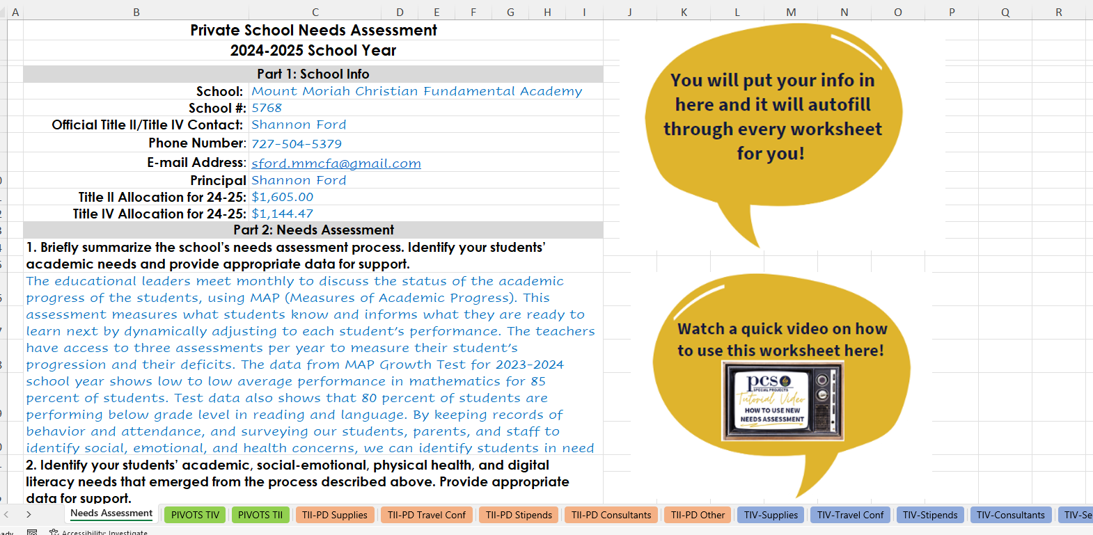
Title II/IV Needs Assessment Details

Slide 21
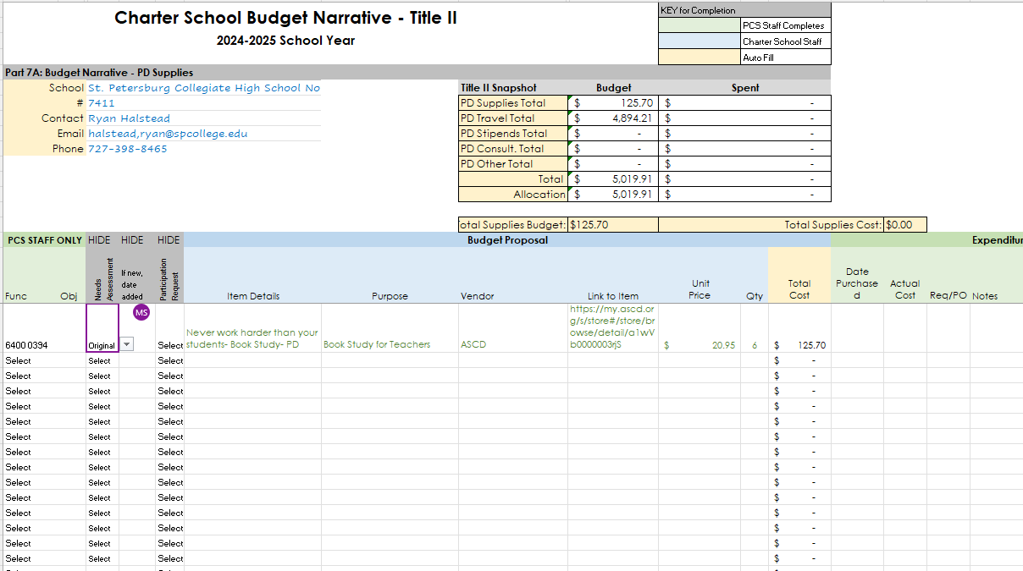
Title II/IV Needs Assessment Details

Slide 22

Title II/IV Needs Assessment Details

Slide 23
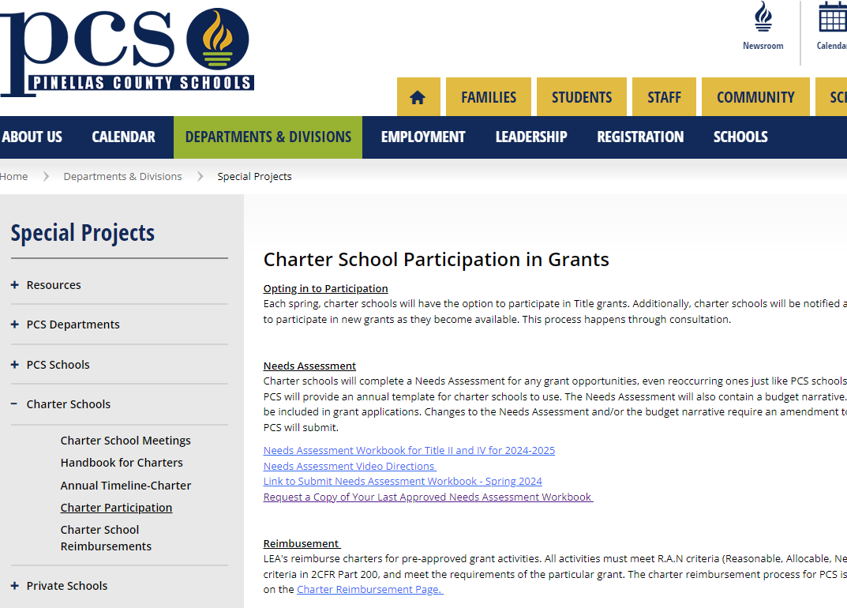
Title II/IV Needs Assessment Details

Slide 24
Title II/IV Amendments
Email Invite
Review Needs Assessment
Schedule Session with Calendly
Prepare Changes Ahead of Time
Wait for FDOE Approval to Spend
Meet on Teams and Make Changes Live
Amendments will occur in Fall, Winter and Spring and schools will receive email notification the month prior so they will have an opportunity to request changes to their budget.

Slide 25
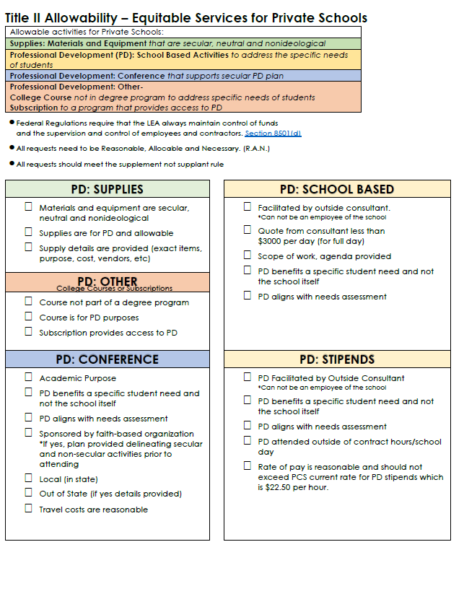
Title II/IV Reminders
R. A. N
Responsibility, Allocable, Necessary

Slide 26
Title II/IV Reminders
R. A. N
Responsibility, Allocable, Necessary

Slide 27
Title II/IV Reminders
R. A. N
Responsibility, Allocable, Necessary

Slide 28


Wrap Up

Slide 29
Part 6:
Wrap Up

Slide 30

Q&A

